Slide 1
ONLINE VOTING SYSTEM
T . Harsha Vardhan (211801380019)
S . Mohan (211801380025)
G . Gangadhar (211801380016)
T . Sai Venkatesh (211801380035)

Slide 2
ABSTRACT
An online voting system is a platform designed to facilitate secure and efficient voting processes over the internet.
With the use of advanced encryption algorithms and authentication protocols, our online voting system ensures the privacy, confidentiality, and integrity of each vote cast.
The motive of this project to make the voting system easiest.

Slide 3
INTRODUCTION
Online Voting is a web-based voting system that will help you manage your elections easily and securely.
Our online voting system website is designed to provide a user-friendly for voters.
With our online voting system website, we aim to revolutionize the voting process by making it more accessible, convenient, and secure for everyone.

Slide 4
EXISTING SYSTEM
The existing system of voting system is highly manual else online system is unsecure.
Registration of voters is a time consuming process to get the voter id in the current system.
No security is provided during the voting process.

Slide 5
DISADVANTAGES
Security Risks
Lack of Accessibility
Technical Issues
Cost
Lack of Transparency

Slide 6
PROPOSAL SYSTEM
Here we are proposing an web application for voting process over the internet .
Voter registration is more secure as it is done through OTP.
The proposed system is more reliable, faster, accurate and easy to handle compared to existing manual system.

Slide 7
ADVANTAGES
Accessibility
Cost-Effective
Efficiency
Increased voter turnout
Security

Slide 8
System Requirements
Hardware Requirements:
I3 (Processor)
4GB (RAM)
Software Requirements:
Any Web Browser
Vs code (or) Notepad
Front end Requirements:
HTML
CSS
Java Script
Backend Requirements:
PHP
Twilio Server
Xampp Server

Slide 9
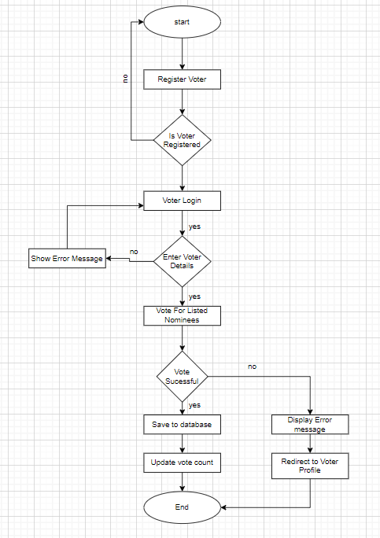
System Flowchart

Slide 10
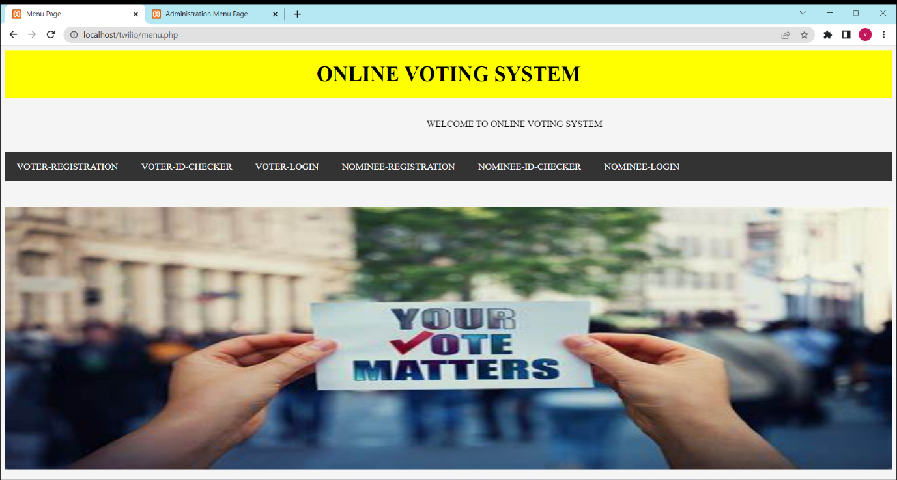
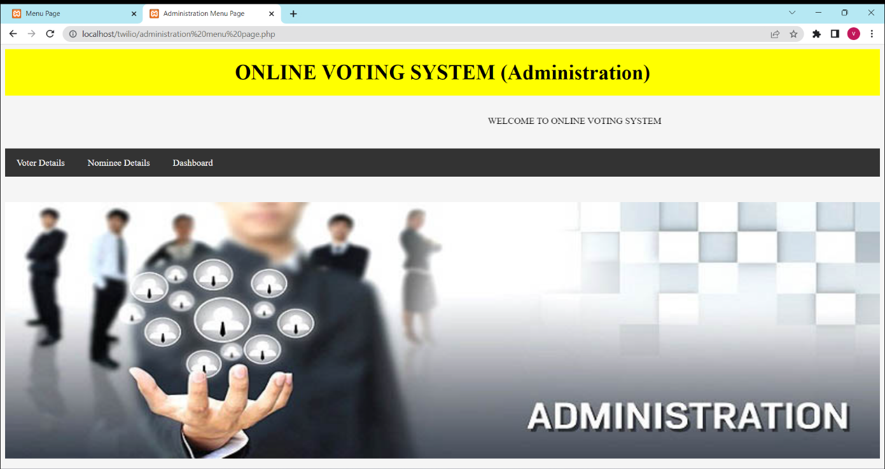
OUTPUT

Slide 11
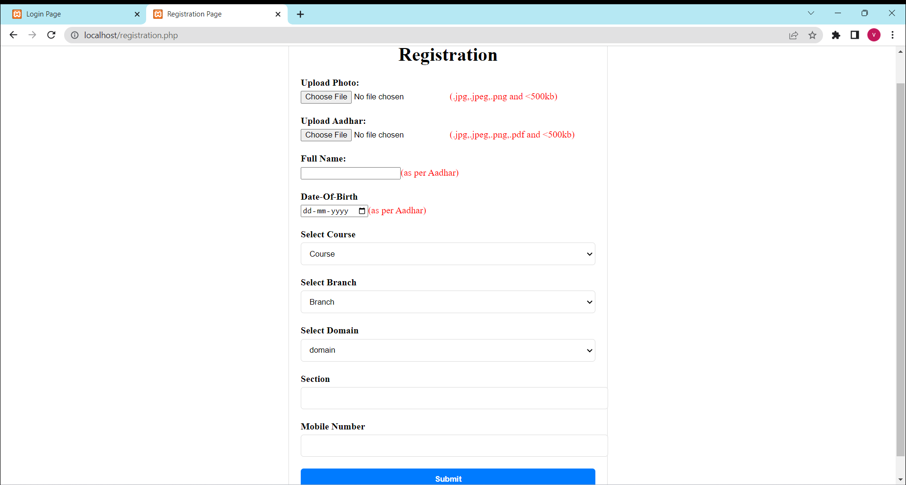
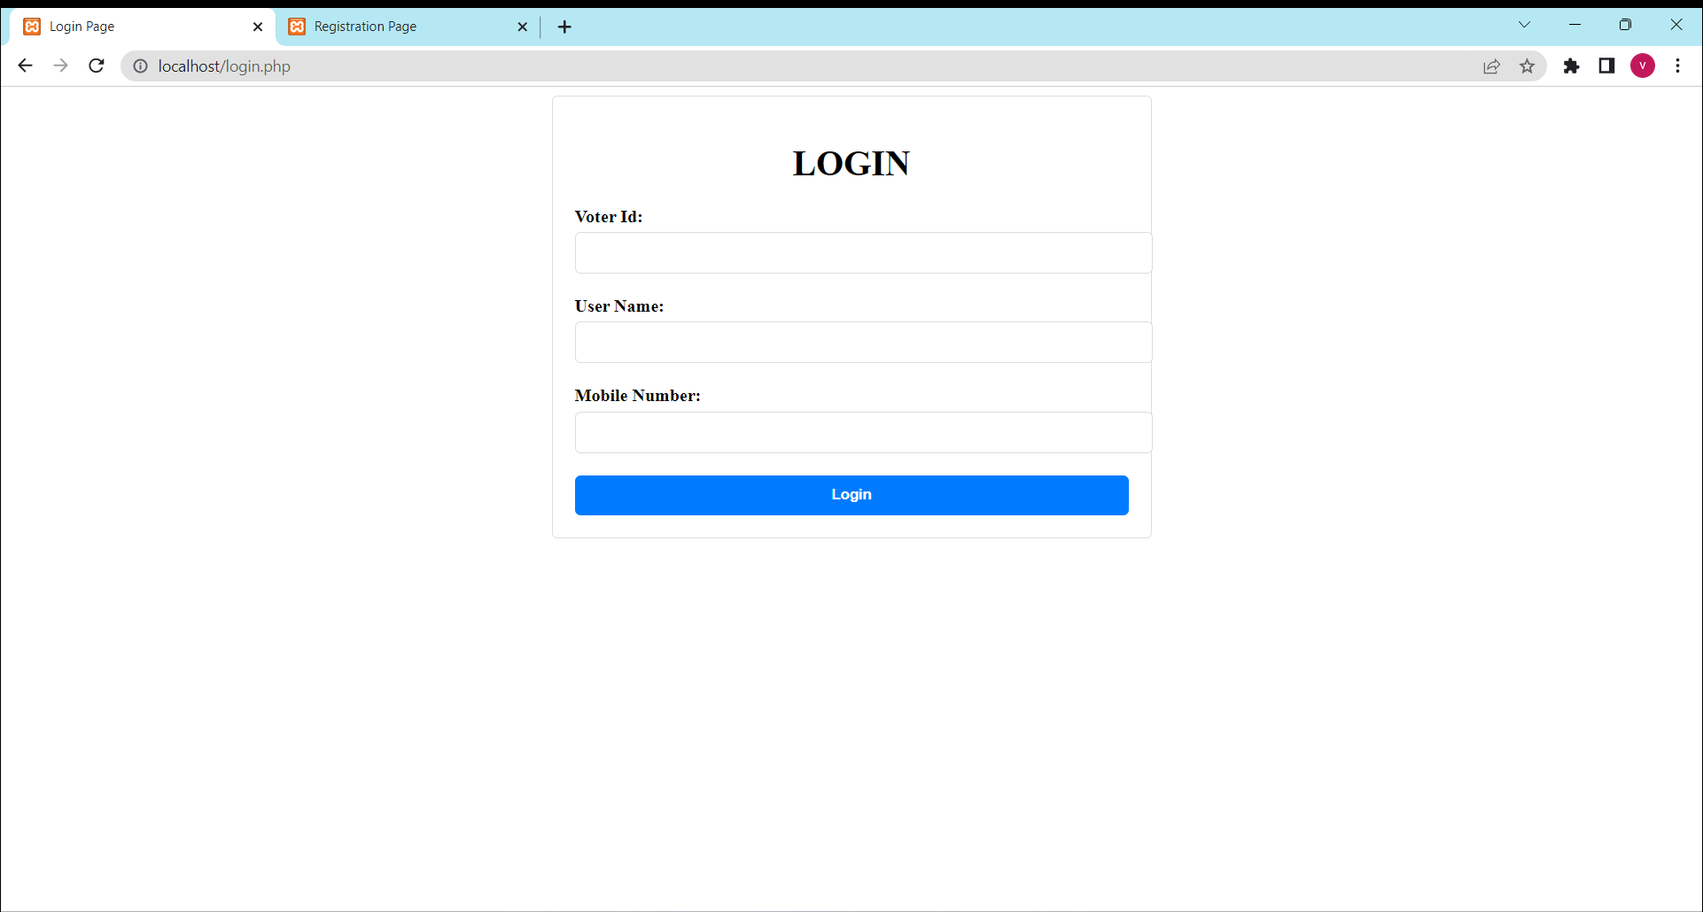

Slide 12
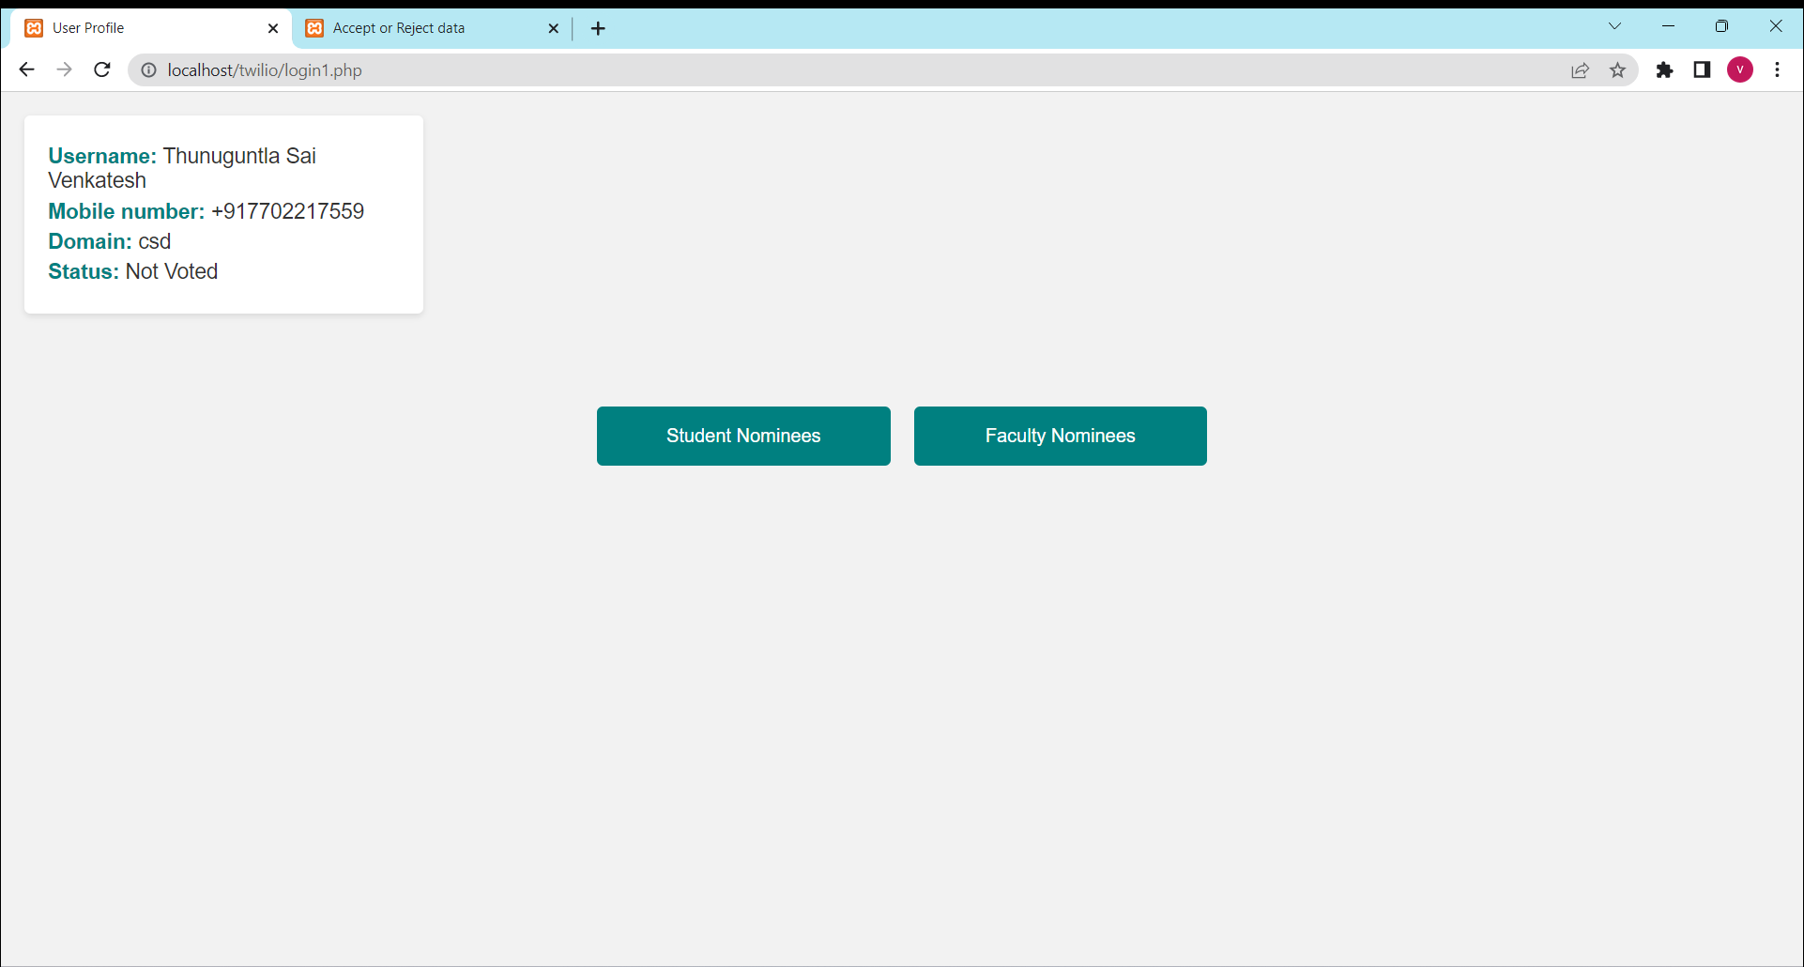

Slide 13
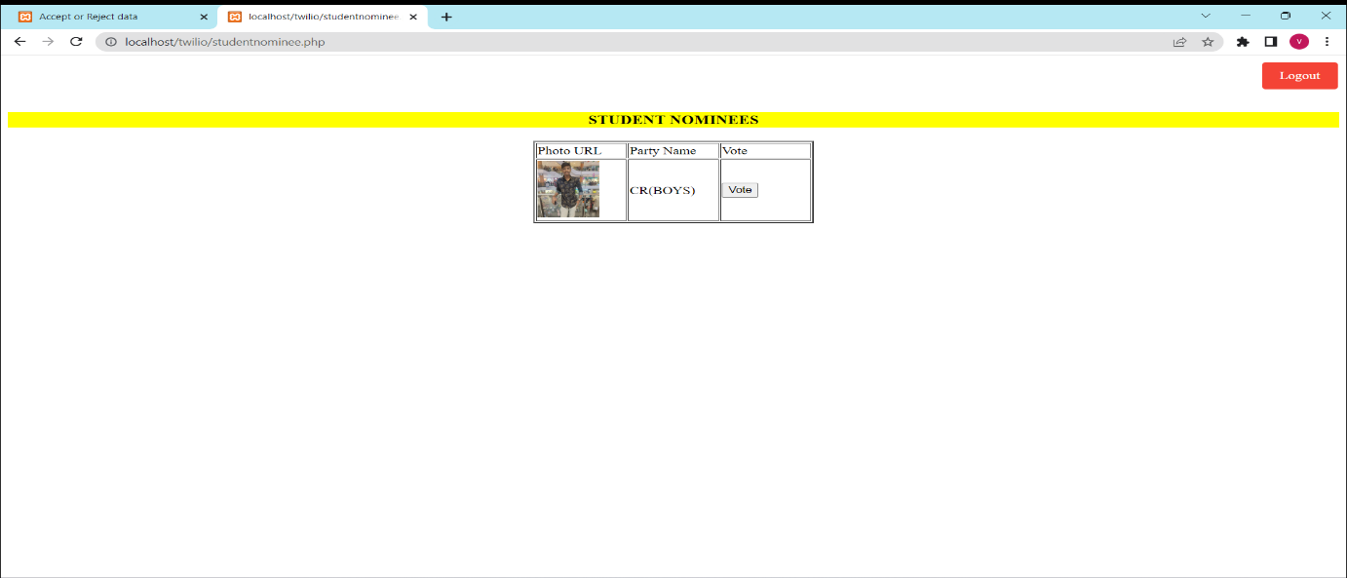
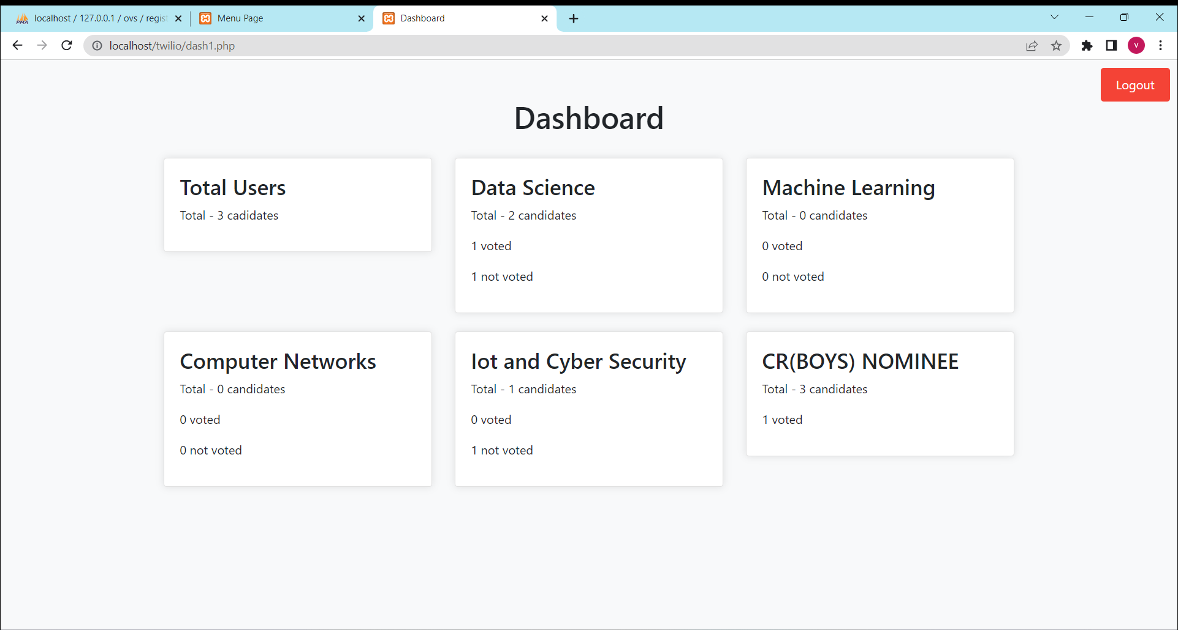

Slide 14
Conclusion
By this project we can conclude that, our voting system will, ensure every individual irrespective of their educational qualification can utilize the right to vote.

